Slide 1
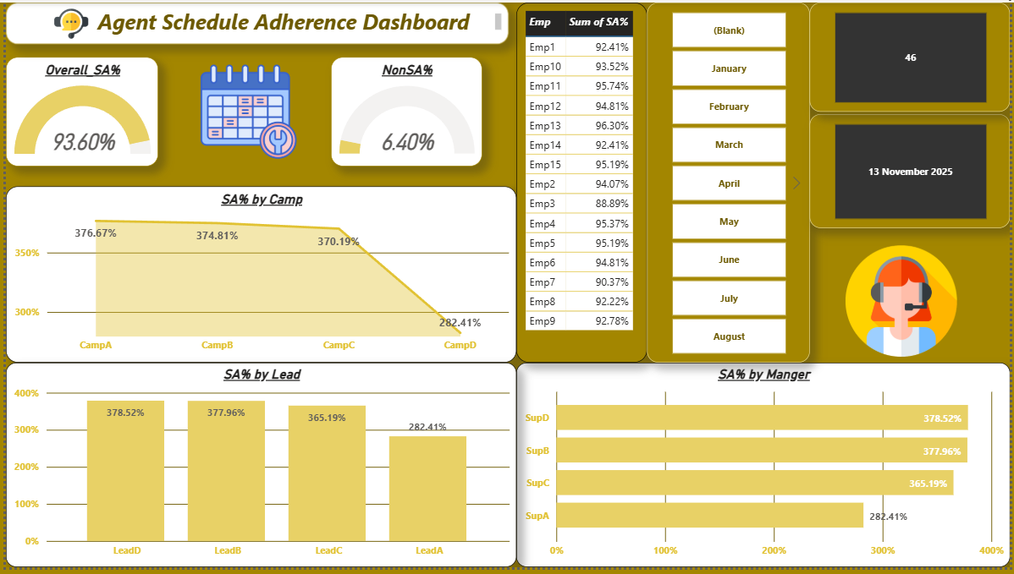

Slide 2





Effective delivery techniques
To understand all requirements and take action. The first thing I have to keep in mind is the report deadline. So, I choose the technology and techniques below here:
  Power Bi (Dashboard Creation)
  Excel and Power Query for Data Cleaning
  DAX and Calculated columns for Calculations.
  Charts and icons for effective representation
  Cards and dynamic filters.

Slide 3
Thank you
Raj
+91 7220919815
rajkumarcsemitrc2020@gmail.com
hppts://github.com/rajkumar2010101

